Slide 1
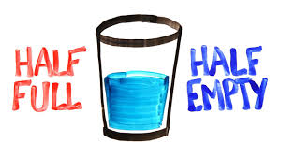
“Half Full” OR "Half Empty”?

Slide 2
“Half Full” OR "Half Empty”?
1. Be grateful that you have a glass!

Slide 3
“Half Full” OR "Half Empty”?
2. Be grateful there is something in the glass!

Slide 4
“Half Full” OR "Half Empty”?
3. People who wonder whether the glass is half empty or half full are missing the point: The glass is refillable.

Slide 5
“Half Full” OR "Half Empty”?
4. Empowered people don’t look at the glass as being half empty or half full because they are too busy filling it!

Slide 6
“Half Full” OR "Half Empty”?
5. If you see your glass as being half empty, pour it into a smaller glass.

Slide 7
“Half Full” OR "Half Empty”?
6. Why is the glass there in the first place? And why is there water all over the floor?

Slide 8
“Half Full” OR "Half Empty”?
7. It’s impossible for exactly half of a glass to be full.

Slide 9
“Half Full” OR "Half Empty”?
8. While you’re arguing about the glass of water, I drank it.

Slide 10
“Half Full” OR "Half Empty”?
9. You can’t look at a glass half full or half empty if it’s over flowing.

